Slide 1

What is Spock:
Spock is a testing and specification
framework for Java and Groovy applications
Spock is inspired from:
JUnit, RSpec, jMock, Mockito, Groovy, Scala, Vulcans, and other fascinating life forms.

Slide 2



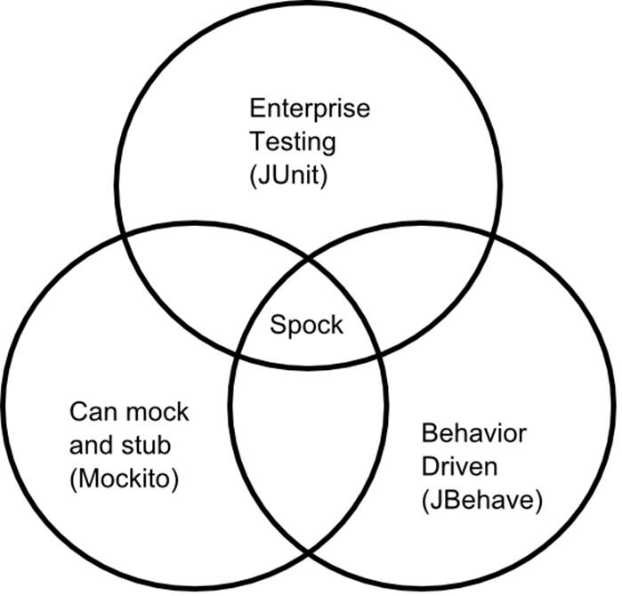

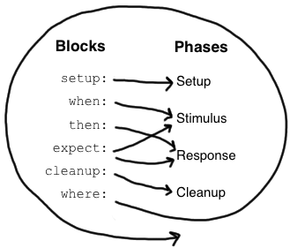



Slide 3

Apache Groovy is a powerful, optionally typed and dynamic language, with static-typing and static compilation capabilities, for the Java platform aimed at improving developer productivity thanks to a concise, familiar and easy to learn syntax.
Concise, brief, direct syntax
Relatively short learning curve (java syntax compatible)
Extents the java library (especially collections are extended)
Support for closures (open, anonymous, block of code that can take arguments,
return a value and be assigned to a variable)
Optionally type
Does not care about access modifiers (no more reflection to set that private field
in your class under test)
Great for creating DSL’s (Spock, Gradle, Spring integration)

Slide 4
Specification
class OrderServiceTest extends Specification {
Spock console
http://meetspock.appspot.com/
Spock documentation
http://spockframework.org/spock/docs/1.0/spock_primer.html
Spock examples
http://thejavatar.com/testing-with-spock/
Example Code
https://github.com/chjansen/SpockExample

Slide 5
def "should return 2 from first element of list"() { given: List<Integer> list = new ArrayList<>() when: list.add(1) then: 2 == list.get(0) }
@Unroll
def "numbers to the power of two"(int a, int b, int c) { expect: Math.pow(a, b) == c where: a | b | c 1 | 2 | 1 2 | 2 | 4 3 | 2 | 9 }

Slide 6
Mock
A mock is a dummy class replacing a real one, returning something like null or 0 for each method call
Stub
A stub is also a dummy class providing some more specific, prepared or pre-recorded, replayed results to certain requests under test. You could say a stub is a fancy mock
Spy
A spy is kind of a hybrid between real object and stub, i.e. it is basically the real object with some (not all) methods shadowed by stub methods.

Slide 7
Mock
def paymentGateway = Mock(PaymentGateway)
PaymentGateway paymentGateway = Mock()
paymentGateway.makePayment(_) >> true
paymentGateway.makePayment(_) >>> [true, true, false, true]

Slide 8
Stub
def paymentGateway = Stub(PaymentGateway,)
PaymentGateway paymentGateway = Stub()
Spy
def paymentGateway = Spy(PaymentGateway, constructorArgs: [])
Only overwrites the specified methods other are unaffected
paymentGateway.makePayment(_) >> true

Slide 9
Maven
Lets look at the example project pom

